Slide 1
Introduction to Python Programming 22PLC202 Module 5
Think Python
By
Allen B Downey

Slide 2
Classes and objects Classes and functions Classes and methods

Slide 3
OOPs Concepts in Python
Class
Objects
Polymorphism
Encapsulation
Inheritance
Data Abstraction

Slide 4
Classes and Objects
Till Now
how to use functions
to organize code and built-in types to organize data.
Now
learn “object-oriented programming”, which uses programmer defined types to organize both code and data.
Object-oriented programming is a big topic; let us get to know the glimpse of it

Slide 5
Programmer-defined Data types
A class is a user-defined blueprint or prototype from which objects are created.
Classes provide a means of bundling data and functionality together.
Creating a new class creates a new type of object, allowing new instances of that type to be made.
Each class instance can have attributes attached to it for maintaining its state.
Class instances can also have methods (defined by their class) for modifying their state.

Slide 6
Consider an example, to create a type called Point that represents a point in two-dimensional space.
For example, (0, 0) represents the origin, and (x, y) represents the point x units to the right and y units up from the origin.
There are several ways to represent points in Python:
store the coordinates separately in two variables, x and y.
store the coordinates as elements in a list or tuple.
create a new type to represent points as objects - Creating a new type is more complicated than the other options, but it has advantages.

Slide 7
Python class
Classes are created by keyword class followed by a name, followed by colon(:).
Example : class is a keyword, Point is the name of the class
class Point:

Slide 8
Object of Python Class
An Object is an instance of a Class.
A class is like a blueprint while an instance is a copy of the class with actual values.
An object consists of:
State: It is represented by the attributes of an object. It also reflects the properties of an object.
Behavior: It is represented by the methods of an object. It also reflects the response of an object to other objects.
Identity: It gives a unique name to an object and enables one object to interact with other objects.
Objects can be passed as parameters to functions

Slide 9
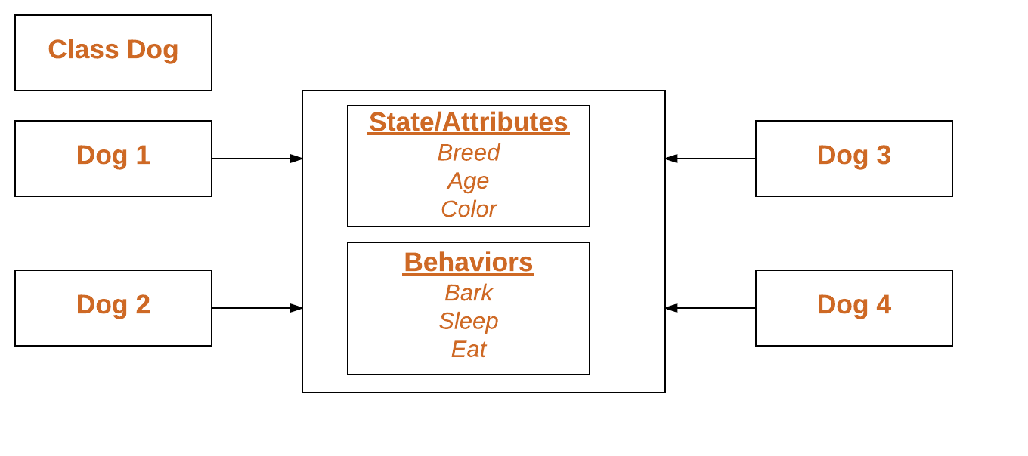
Attributes of Object
Attributes are the variables that belong to a class.
Attributes are always public and can be accessed using the dot (.) operator and assign values to an instance

Slide 10
Rectangles
Design a class to represent rectangles.
Attributes should specify the location and size of a rectangle
There are at least two possibilities:
specify one corner of the rectangle (or the center), the width, and the height.
specify two opposing corners.

Slide 11
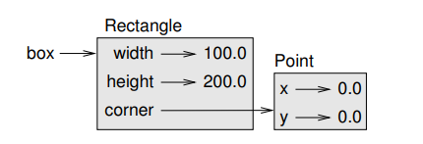
class Rectangle:
box = Rectangle() # object
box.width = 100.0 # Attribute
box.height = 200.0 # Attribute
box.corner = Point() # Attribute of type object
box.corner.x = 0.0
box.corner.y = 0.0
box.corner.x means, “Go to the object box and select the attribute named corner; then go to that object and select the attribute named x.”

Slide 12
Instances as return values
Functions can return instances.
For example,
find_center takes a Rectangle as an argument and returns a Point that contains the coordinates of the center of the Rectangle:
def find_center(rect):
p = Point()
p.x = rect.corner.x + rect.width/2
p.y = rect.corner.y + rect.height/2
return p
Here is an example that passes box as an argument and assigns the resulting Point to center:
center = find_center(box)
print_point(center)
def find_center(rect):
p = Point()
p.x = rect.corner.x + rect.width/2
p.y = rect.corner.y + rect.height/2
return p
center = find_center(box)
print_point(center)

Slide 13
Objects are mutable
The state of an object can be changed by making an assignment to one of its attributes.
For example, to change the size of a rectangle without changing its position, the values of width and height can be modified
Also functions can be written to modify objects.
For example, grow rectangle takes a Rectangle object and two numbers, dwidth and dheight, and adds the numbers to the width and height of the rectangle:
Inside the function, rect is an alias for box, so when the function modifies rect, box changes.
box.width = box.width + 50
box. Height = box.height + 100
def grow_rectangle(rect, dwidth, dheight):
rect.width += dwidth
rect.height += dheight
Print(box.width, box.height)
# (150.0, 300.0)
grow_rectangle(box, 50, 100)
Print(box.width, box.height)
# (200.0, 400.0)

Slide 14
Write a function named move_rectangle that takes a Rectangle and two numbers named dx and dy. It should change the location of the rectangle by adding dx to the x coordinate of corner and adding dy to the y coordinate of corner.
class Rectangle: def __init__(self, x, y, width, height): self.x = x self.y = y self.width = width self.height = height def move_rect(rectangle, dx, dy): rectangle.x += dx rectangle.y += dy rect = Rectangle(1, 2, 5, 6) print("Original Rectangle:", rect.x, rect.y, rect.width, rect.height) move_rect(rect, 3, -2) print("Moved Rectangle:", rect.x, rect.y, rect.width, rect.height)
Original Rectangle: 1 2 5 6
Moved Rectangle: 4 0 5 6

Slide 15
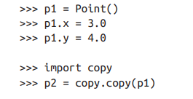
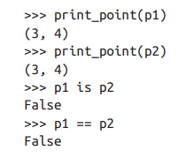
Copying
Aliasing can make a program difficult to read because changes in one place might have unexpected effects in another place.
It is hard to keep track of all the variables that might refer to a given object.
Copying an object is often an alternative to aliasing.
The copy module contains a function called copy() that can duplicate any object: copy.copy()
p1 and p2 contain the same data, but they are not the same Point.

Slide 16
The is operator indicates that p1 and p2 are not the same object
The default behavior of the == operator is the same as the is operator
It checks object identity, not object equivalence.
Python doesn’t know what should be considered equivalent for programmer-defined types

Slide 17
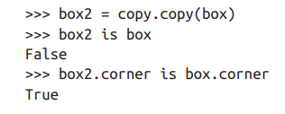
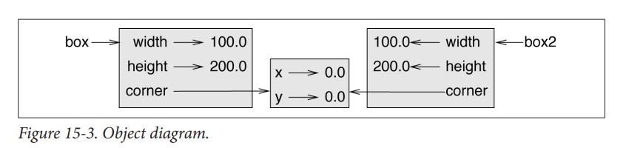
This operation is called a shallow copy because it copies the object and any references it contains, but not the embedded objects

Slide 18
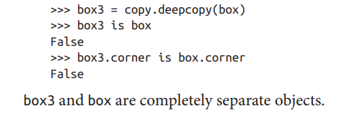
deepcopy() copies not only the object but also the objects it refers to, and the objects they refer to, and so on.

Slide 19
6. Develop a program to sort the contents of a text file and write the sorted contents into a separate text file. [Hint: Use string methods strip(), len(), list methods sort(), appeand(), and file methods open(), readlines(), and write()].
import os
infile=open('C:\\Users\\Smitha\\Desktop\\new.txt')
words=[ ]
for l in infile:
temp=l.split()
for i in temp:
words.append(i)
infile.close()
print(words)
words.sort()
print(words)
outfile=open('res.txt','w')
for i in words:
outfile.write(i)
outfile.write(' ')
outfile.close()

